Slide 1
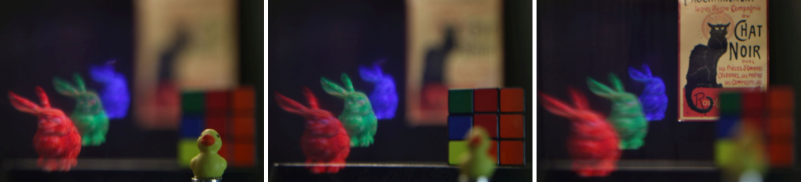
An Extended Depth-of-Field Volumetric Near-Eye AR Display
Kishore Rathinavel, Hanpeng Wang, Alex Blate, Henry Fuchs
UNC Chapel Hill
This research was supported in part by NSF grant 1405847, by a research gift from Intel Corporation, and by the BeingTogether Center, a collaboration between Nanyang Technological University (NTU) Singapore and University of North Carolina (UNC) at Chapel Hill. Thanks also to Peter Lincoln, Andrei State, and Jim Mahaney for helpful discussions.
Notes:
Today, I shall talk to you about a our new approach to address one of the key limitation in current generation virtual reality and augmented reality displays.

Slide 2
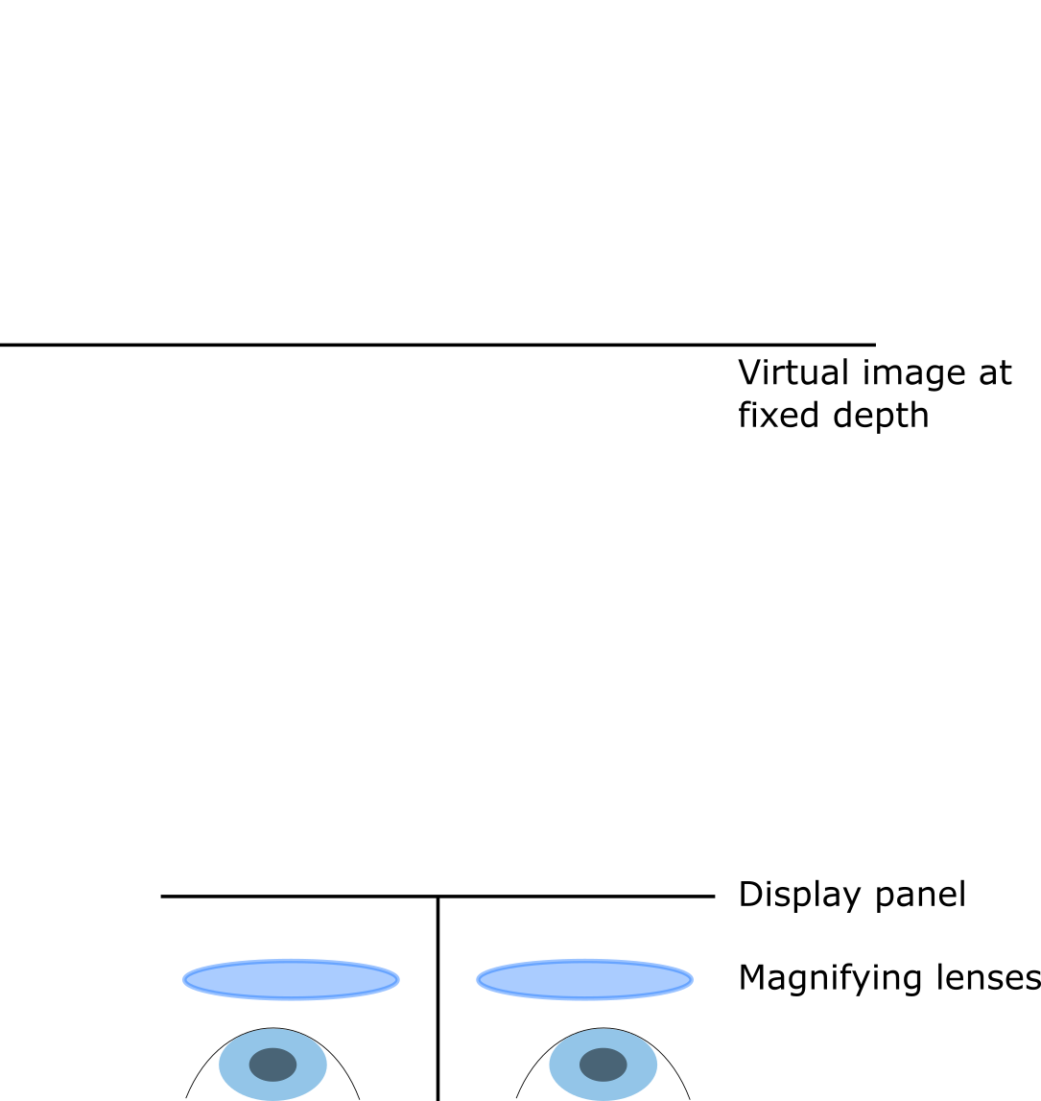
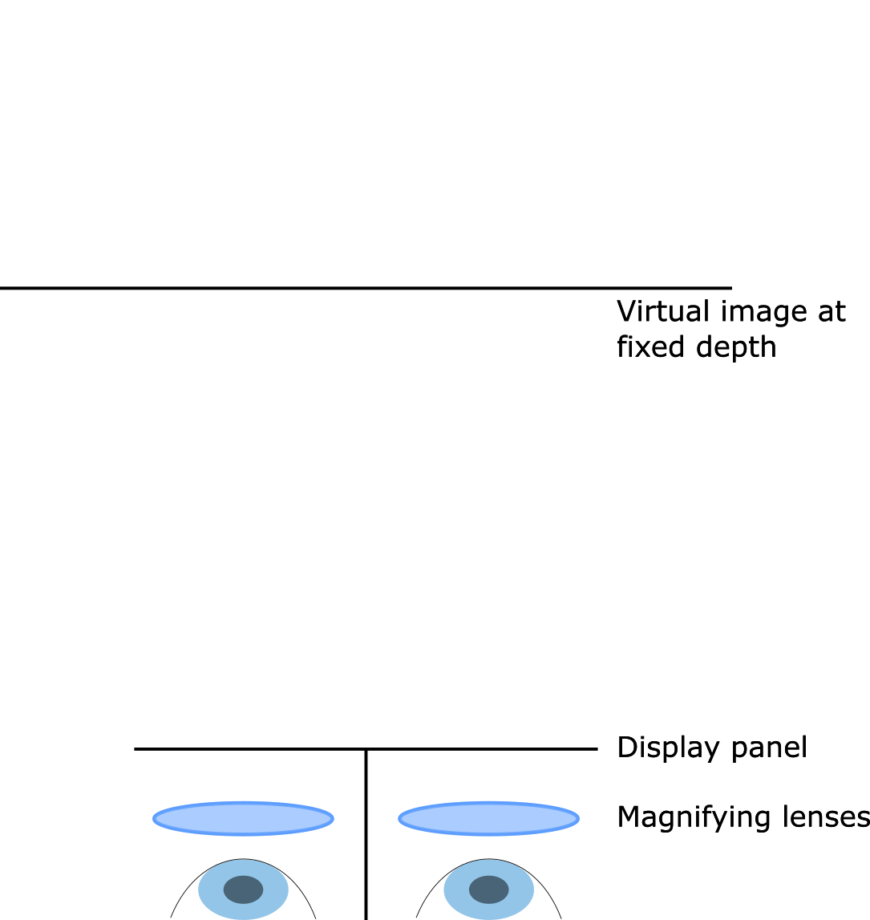
VR Displays today
Notes:
Consider the standard VR display today. It has a display panel and a magnifier lens that forms the image of the display panel at some distance away from the eyes - the distance at which this image is formed is fixed.

Slide 3
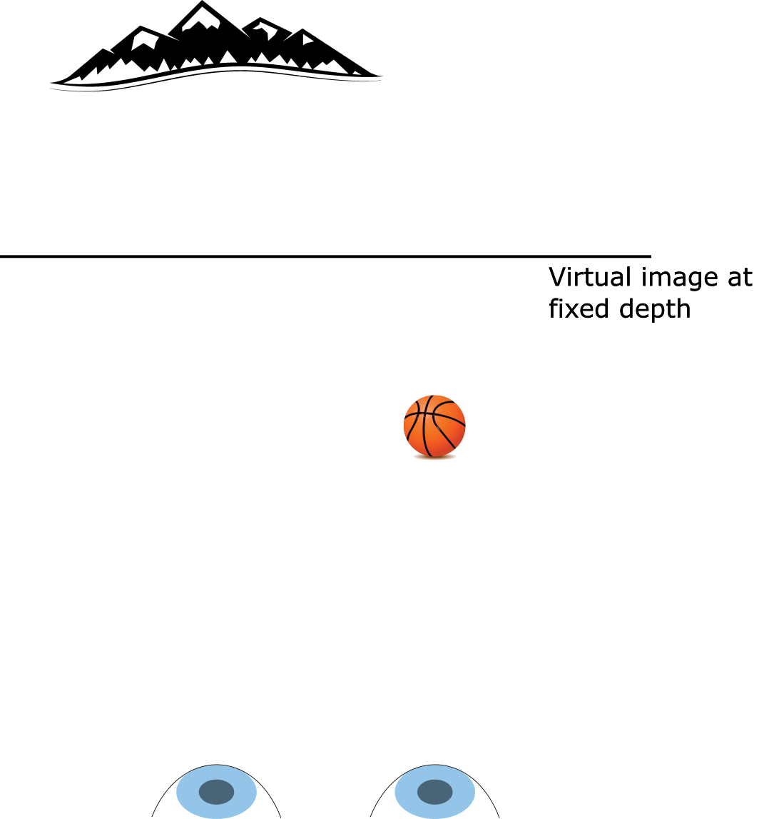
Virtual scene to depict
Notes:
While this distance is fixed, the virtual world that is presented occupies various other depths as well.

Slide 4
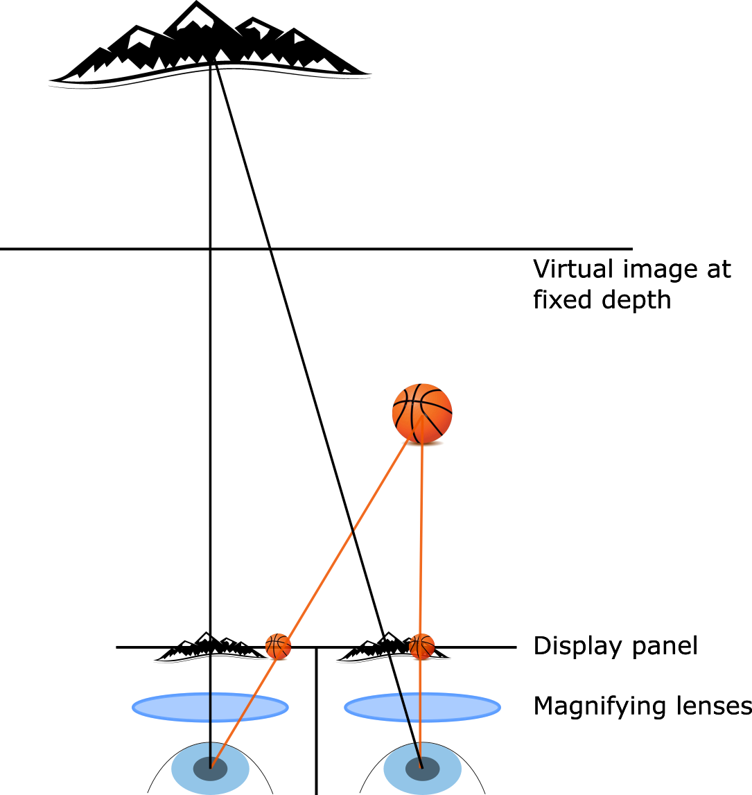
Vergence in VR Displays
Notes:
Since we have one display panel per eye, we can render the virtual world from two different perspectives and present a binocular set of images to the eyes - so the eyes can verge at the proper distance and observe the virtual world with correct parallax or correct binocular cues.

Slide 5
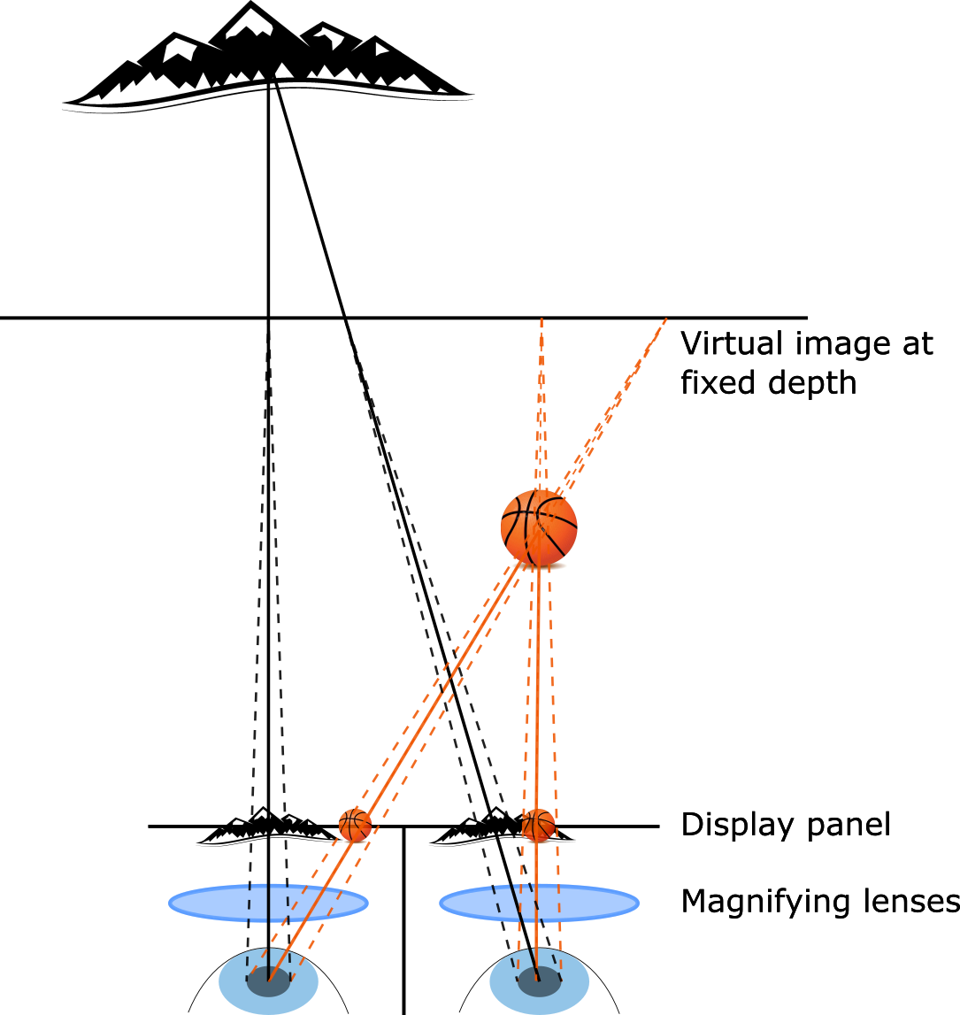
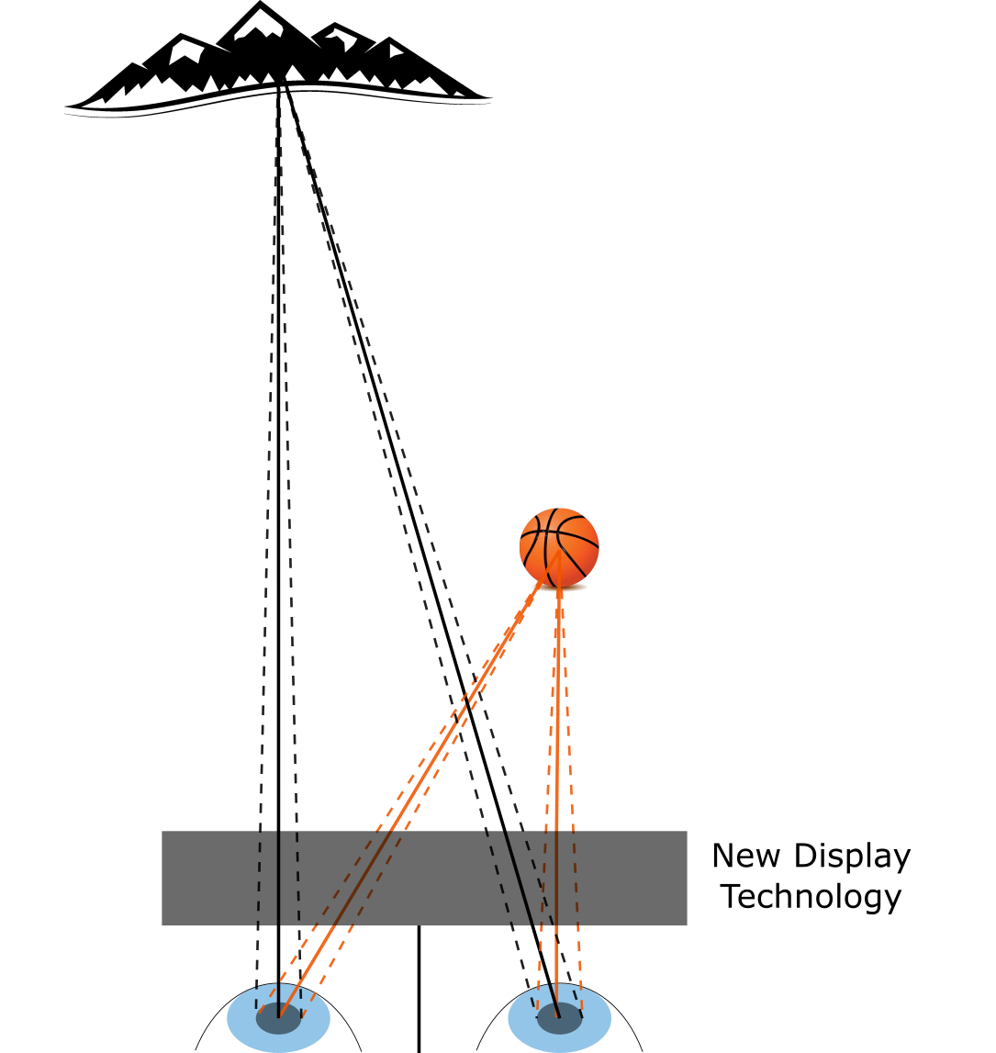
Problem Statement: Vergence-Accommodation Conflict
Display With Conflict
Display Without Conflict
Notes:
However, the virtual image plane is still fixed. The effect of this is that while the user verges to different distances to experience the virtual world, the eye is forced to focus to this virtual image plane which is at a fixed distance. So the user is getting conflicting depth cues. This conflict is called the vergence-accommodation conflict.
This causes discomfort, headaches, and in some cases nausea. For any hope of wearing a VR or AR display for long hours, this problem must be solved, especially for the younger users of AR technology.
ADVANCE
For a display that solves the vergence accommodation conflict, the light rays will appear to originate from the virtual objects when considering both binocular and monocular cues.

Slide 6
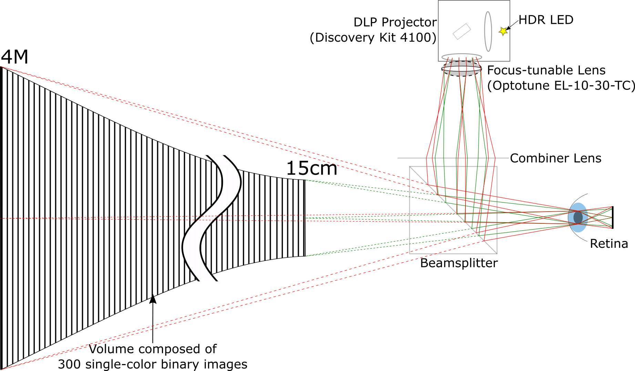
Our Approach: Display Overview
Notes:
Our solution is to build a high-speed near-eye display that sweeps out a dense set of virtual images. Before diving into the details, let me just give you an idea of the dimensions of the volume.

Slide 7
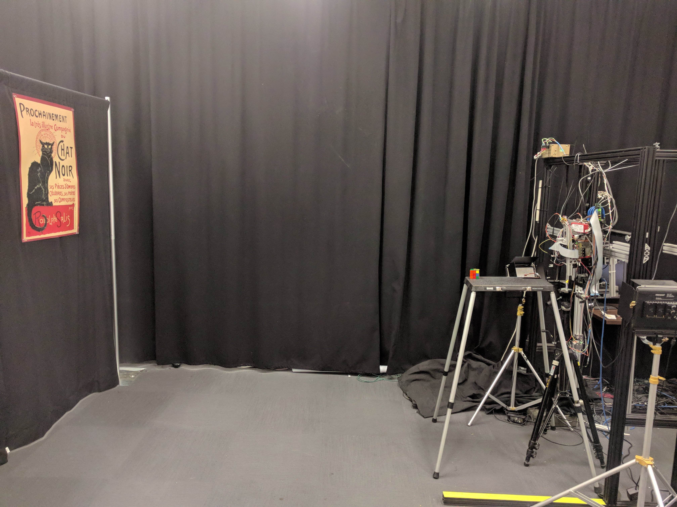
Lab Space
Notes:
Here's our lab space that we used for this project. From the display which is on the right to the wall on the left is 4M.

Slide 8
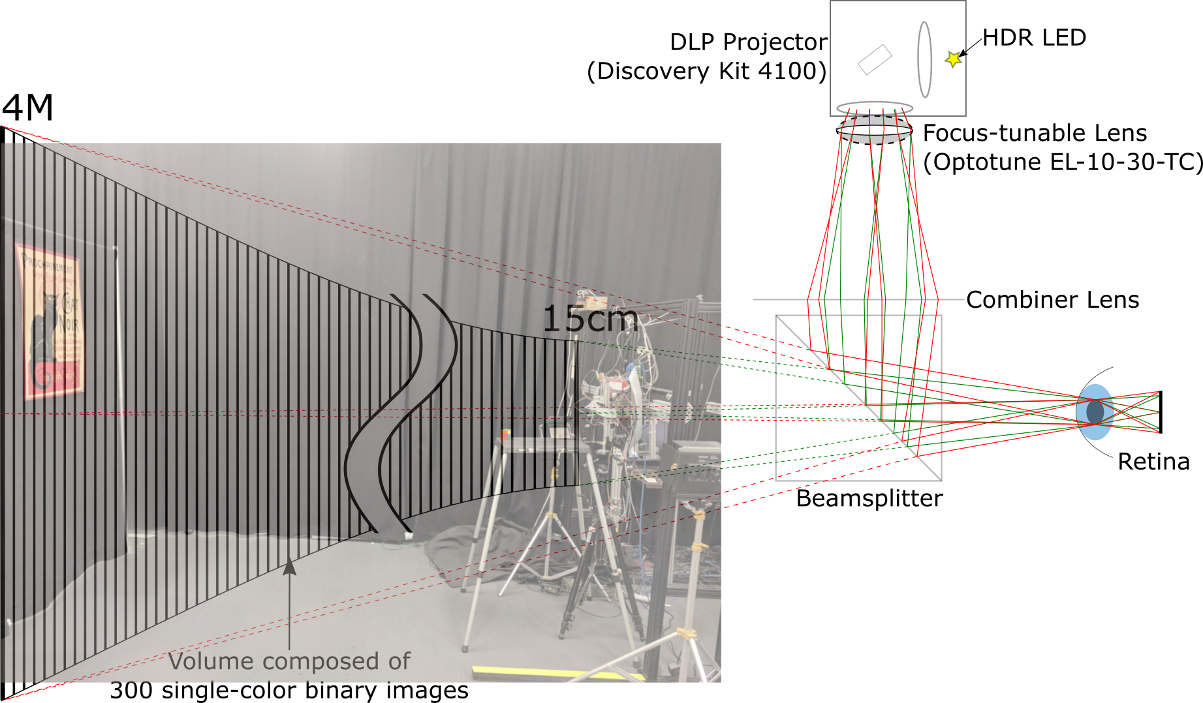
Display Overview
Notes:
Our display is able to present imagery across this entire volume.

Slide 9
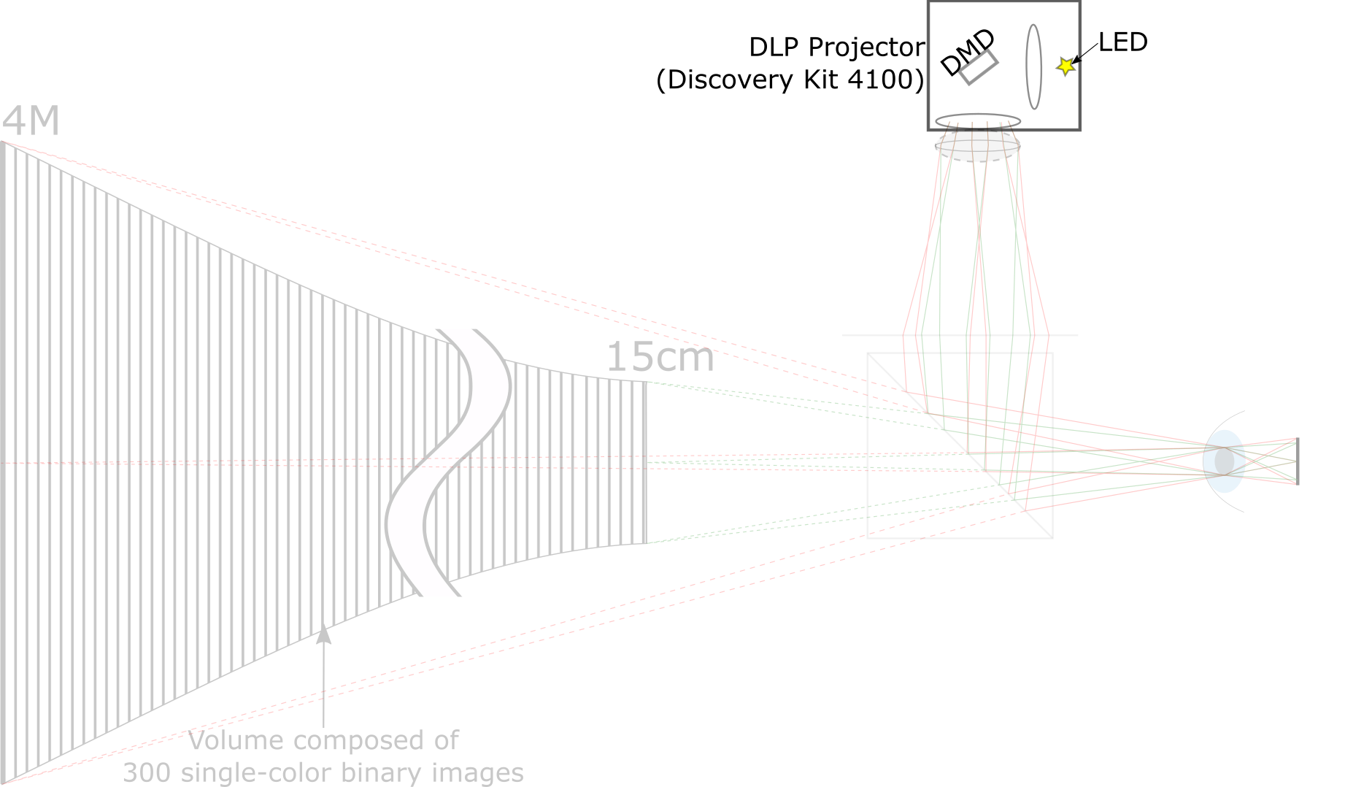
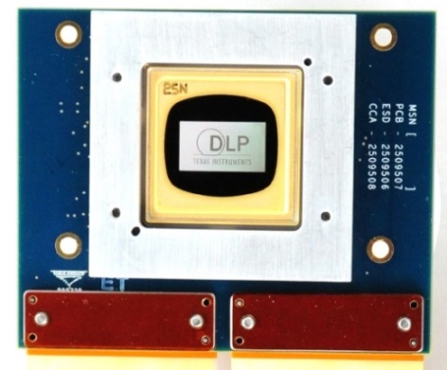
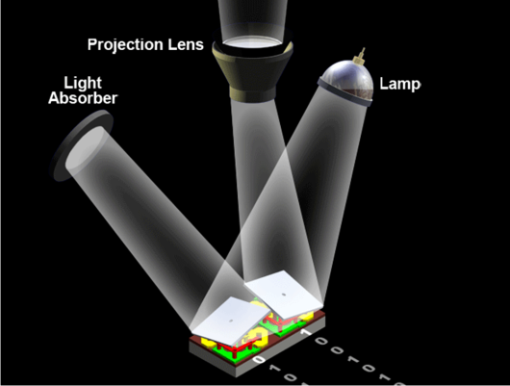
DMD projector
Image Credits: Texas Instruments
Color imagery is generated by binary modulation and persistence of vision
Notes:
Now I'll explain how our display is able to do this. Let's first look at the hardware components of the display. Our display systems uses a DMD projector.
ADVANCE
A DMD chip is composed of several tiny micromirrors that can be flipped either to an on state or off state several thousand times per second, e.g. our DMD chip has a refresh rate of over 17000Hz or 17kHz. When coupled with a light source and projection optics, a DMD chip is essentially a high-speed binary projector - each frame is composed of either a bright pixel or a black pixel. Color imagery is generated using binary modulation and persistence of vision

Slide 10
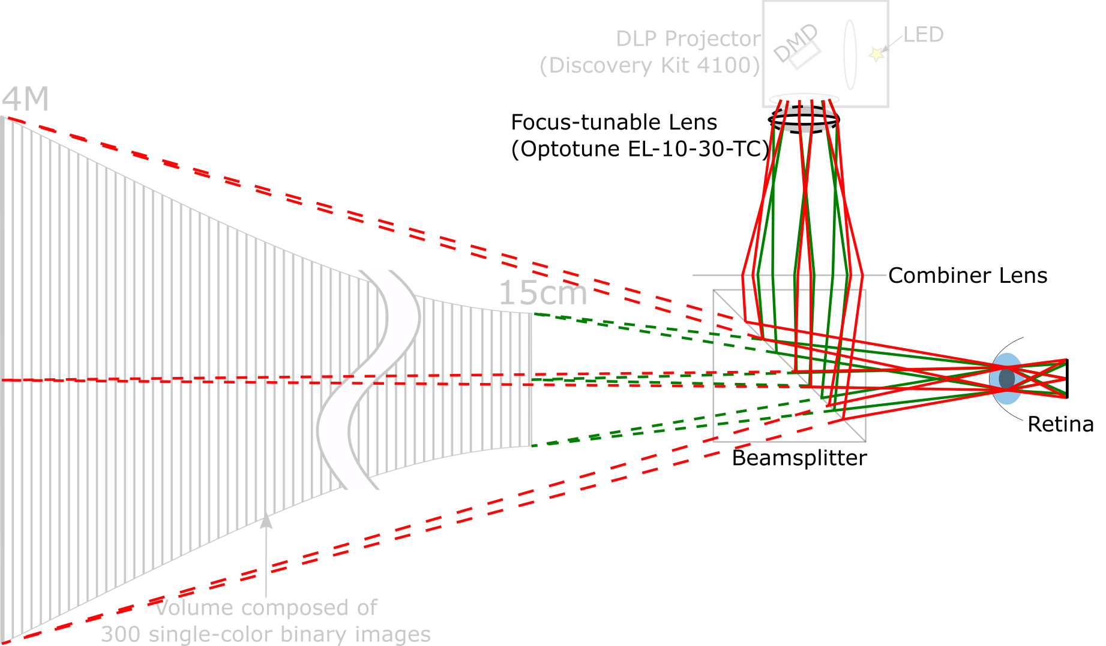
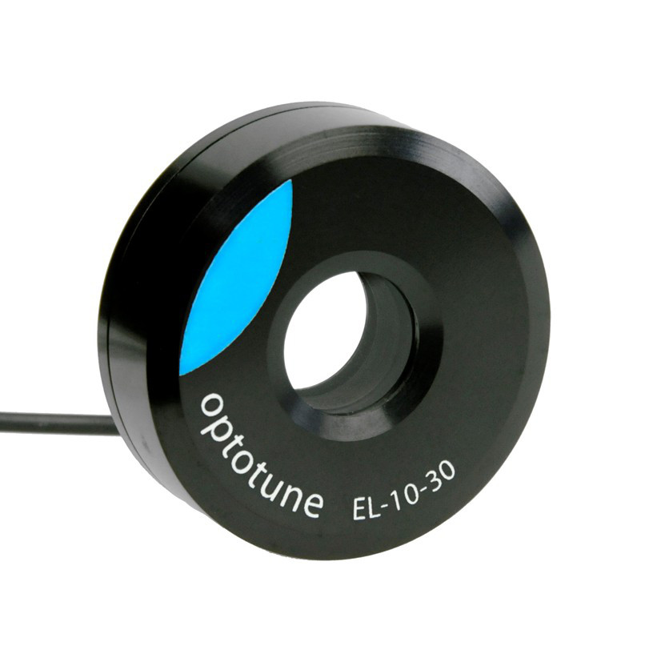
Focus-Tunable Lens
Notes:
A focus-tunable lens is placed at the output of the DMD projector. A focus-tunable lens is a lens whose optical power can be controlled electronically. We change the optical power of the focus-tunable lens according to a periodic waveform e.g. sinusoidal or triangular.

Slide 11
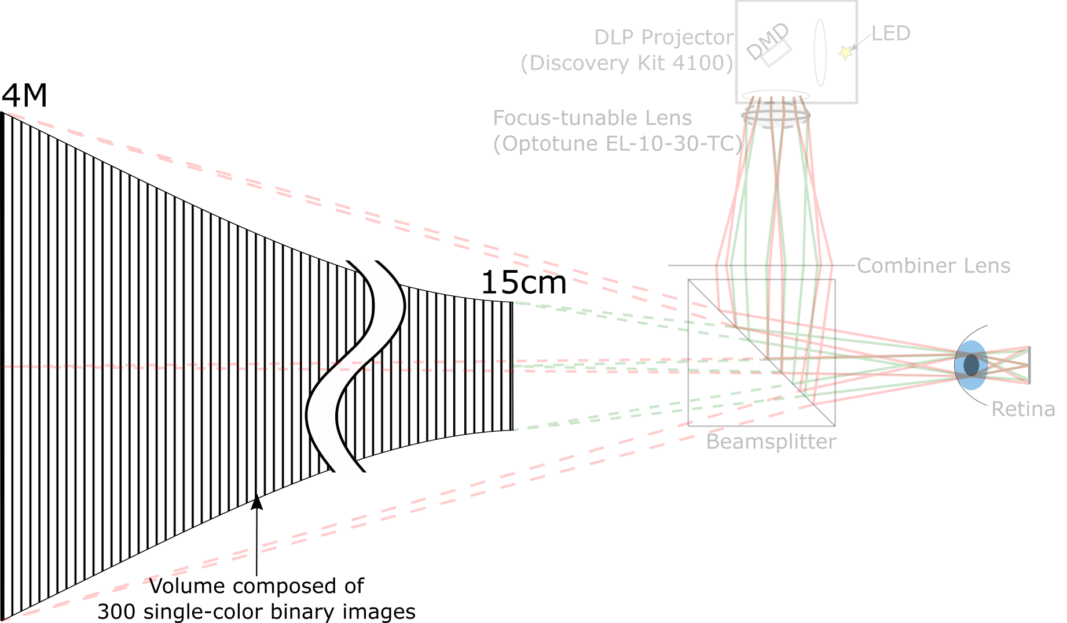
DMD projector and Focus-Tunable Lens are synchronized
Notes:
The effect of this is that the virtual image plane is swept back and forth across the volume periodically. Since we have a high-speed projector, we can change the projected image while the depth plane is being swept and build a color volume.
The duration of the lens cycle is the overall display's framerate. By setting the frequency of the lens to standard display refresh rate of 60 Hz, we are able to get 280 depth planes in each cycle of the lens.

Slide 12
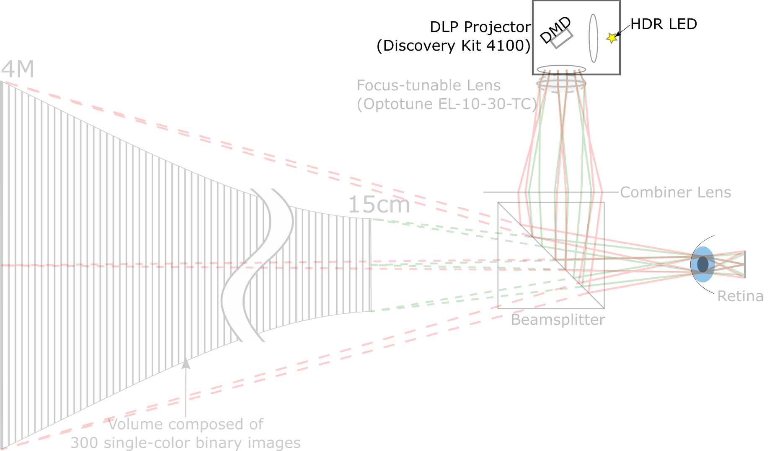
High Dynamic Range (HDR) LED
Notes:
Another component we use is a high dynamic range LED. The LED has independent 16-bit DACs per color channel so it offers a wide range of colors and brightnesses. We use this HDR LED to change the DMD illumination on a per-binary frame basis. We will see later how this becomes very useful.

Slide 13
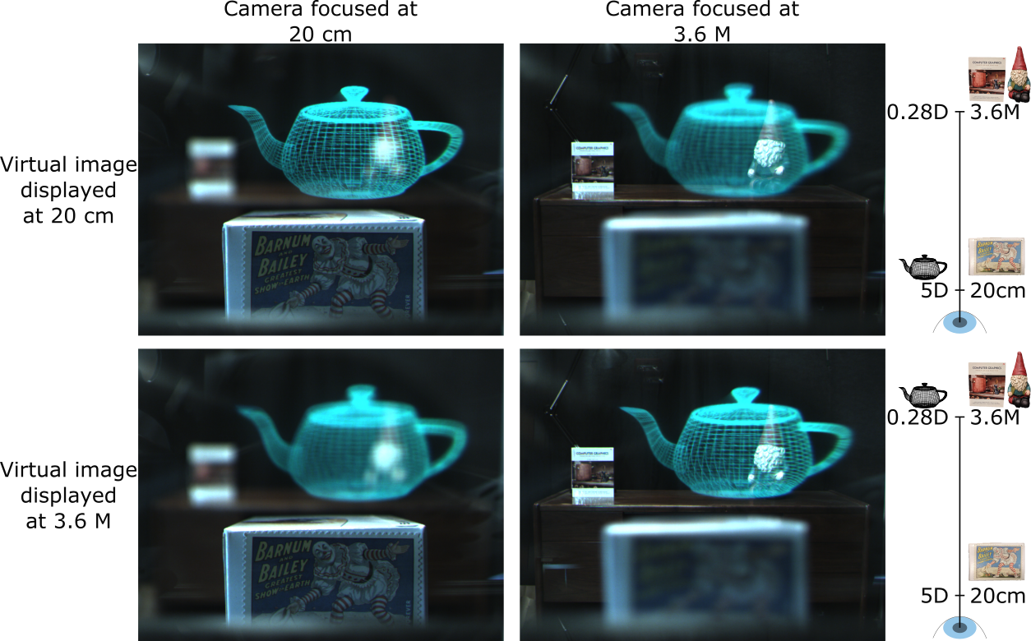
Example of Single-Color Binary Focal Planes
(Camera images were cropped to display’s field of view)
Notes:
Here's an example of binary depth planes.
The legend on the right indicates the relative distances of the real and virtual objects. Objects to the left of the optical axis are virtual objects and the objects to the right are real objects.
Explain image positions

Slide 14
How to decompose a 3D scene to binary images?
Notes:
Now the question is how do we come up with the binary patterns and illumination values to represent a 3-D virtual scene?

Slide 15
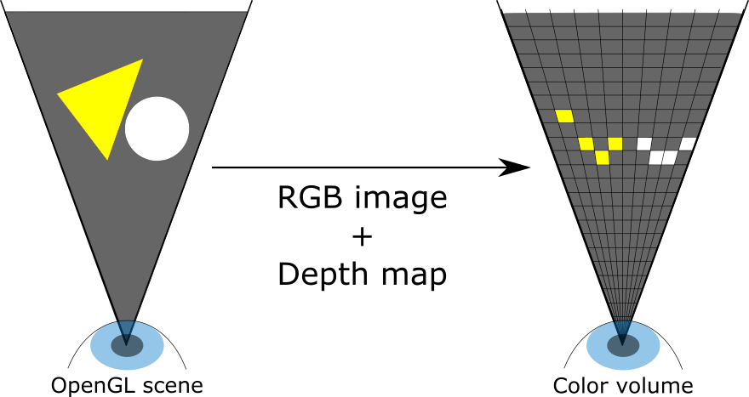
3D Scene to Color Volume
Opaque objects
Notes:
We assume that the virtual objects are all opaque and that we are rendering the view from the center of the pupil. The image on the left shows two example opaque objects. We first convert the 3-D scene to a 2-D surface of color voxels. This is done by rendering the RGB image and depth map of the scene and quantizing the depth map.

Slide 16
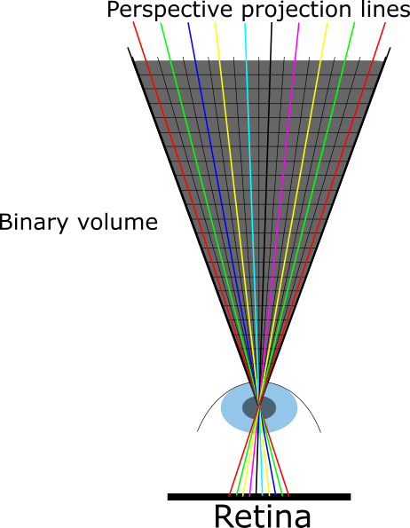
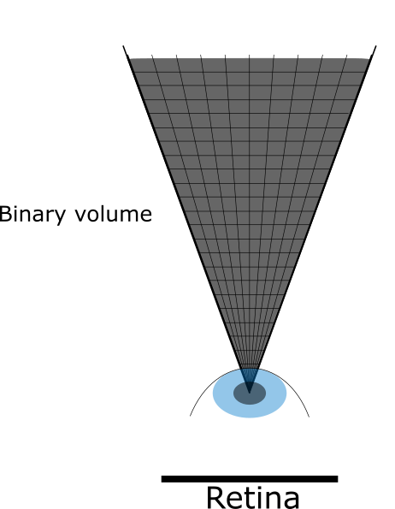
Color to Binary Volume: Main Ideas
The color voxel can be represented by multiple binary voxels as long as the binary voxels are distributed along the perspective projection lines and sufficiently close to the color voxel
Binary representation can start and end at arbitrary depths
Notes:
Now going from the color volume to the binary volume, our key idea is:
The color voxel can be represented by multiple binary voxels as long as the binary voxels are distributed along the perspective projection lines and the binary voxels are sufficiently close to the original color voxel's location. Binary voxels placed along any one of these lines will integrate to a single pixel on the retina.
There can be several decomposition schemes that implement our idea. Here, I'll tell you about a simple scheme.

Slide 17
Color to Binary Volume: Fixed LED Illumination Cycle
LED Illumination cycle for 2 bits-per-color imagery
Frame | 1 | 2 | 3 | 4 | 5 | 6 | …
LED Value | 1R | 2R | 1G | 2G | 1B | 2B
Illumination
LED Illumination cycle for 4 bits-per-color imagery
Frame | 1 | 2 | 3 | 4 | 5 | 6 | 7 | 8 | 9 | 10 | 11 | 12 | …
LED Value | 1R | 2R | 4R | 8R | 1G | 2G | 4G | 8G | 1B | 2B | 4B | 8B
Illumination
Notes:
Our approach is to take advantage of our high dynamic range LEDs. We drive the LEDs color sequentially, and cycle through a set of intensity values that increase exponentially by powers of two. i.e. For a color image of bit-depth 2 per color, the LED illumination cycle looks like this, and for a color image of bit-depth 4, the LED illumination cycle looks like this.

Slide 18
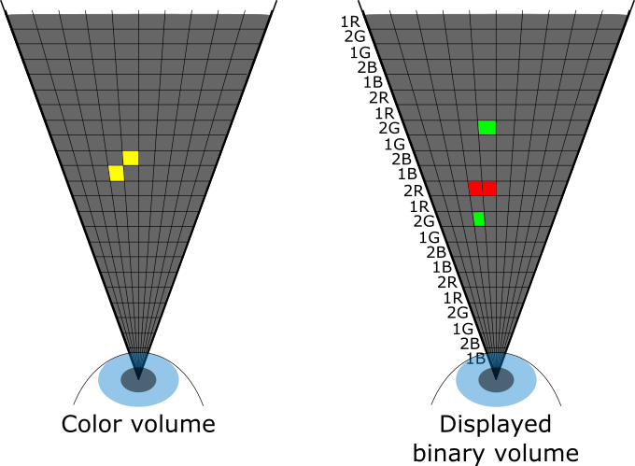
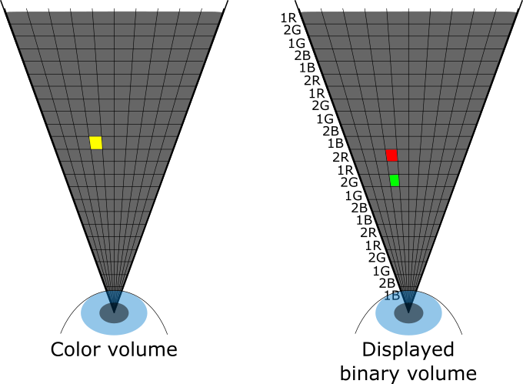
Example decomposition
2R, 2G, 0B
LED Illumination cycle for 2 bits-per-color imagery
Frame | 1 | 2 | 3 | 4 | 5 | 6 | …
LED Value | 2R | 1R | 2G | 1G | 2B | 1B
Illumination
Binary representation for Voxel | 1 | 0 | 1 | 0 | 0 | 0
Notes:
Now let's consider just one color voxel and its decomposition into binary voxels. Say it has a value of 2R,2G,0B. This voxel's color representation is already available to us as: R(10)G(10)B(00).
ADVANCE
The DMD pixel that corresponds to this voxel is simply defined by the current LED illumination and the binary representation of the voxel's color.
ADVANCE
Let's look at the case when there are two pixels near each other but at different depths. Notice how a different depth for green is choosen

Slide 19
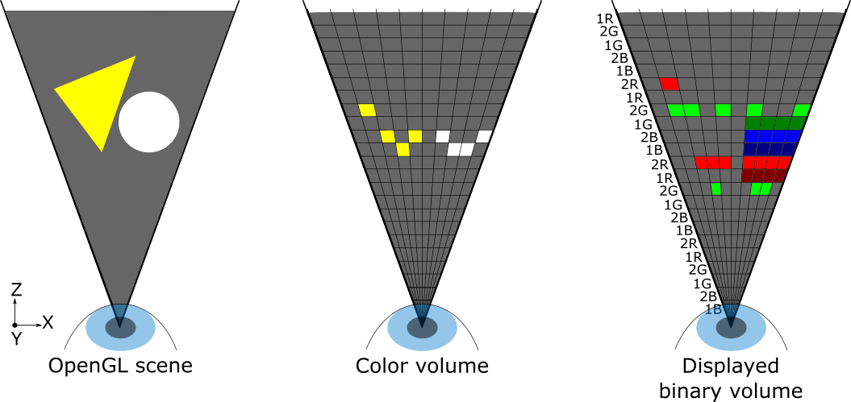
Summary of 3D Scene to Binary Volume Decomposition
280 binary focal planes displayed 60 times per second
Bit-depth: 8 bits-per-color
Implemented cyclically: Color volume and binary volume have same resolution!
Notes:
Let's look at the decomposition of our original scene.
Recall that figure shows an example case for only 2 bits per pixel per color channel, but our actual implementation does 8 bits per pixel per color channel.
Because the lens sweeps the depth plane cyclically, the algorithm can also be implemented cyclically. As a result, the resolution of the color volume and the binary volume match.

Slide 20
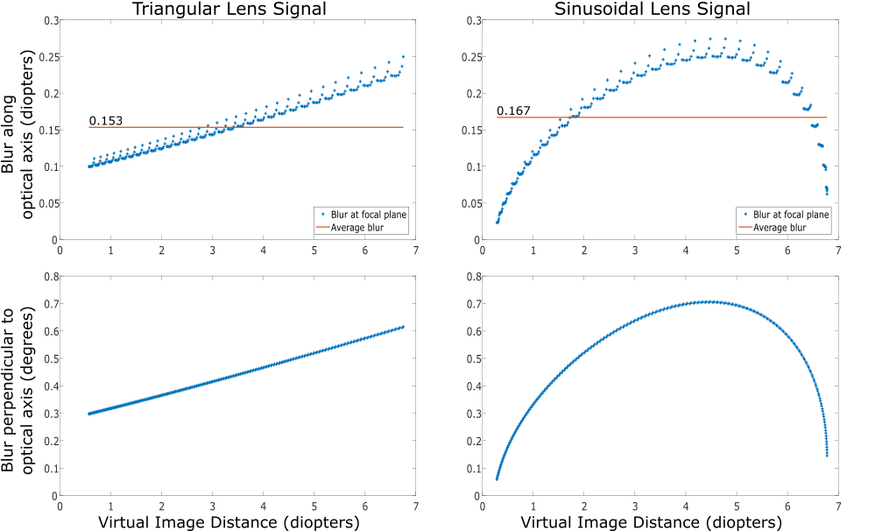
Spatial and Depth Blur of Color Voxels
Most commonly quoted number for acceptable depth blur is 0.3 Diopters.
Notes:
One limitation of this rendering pipeline is that each color voxel is represented by a bunch of binary pixels at different depths - hence there is a loss of depth resolution which we analyzed theoretically and found it to be much better than previous displays and perceptually acceptable even by very conservative standards.

Slide 21
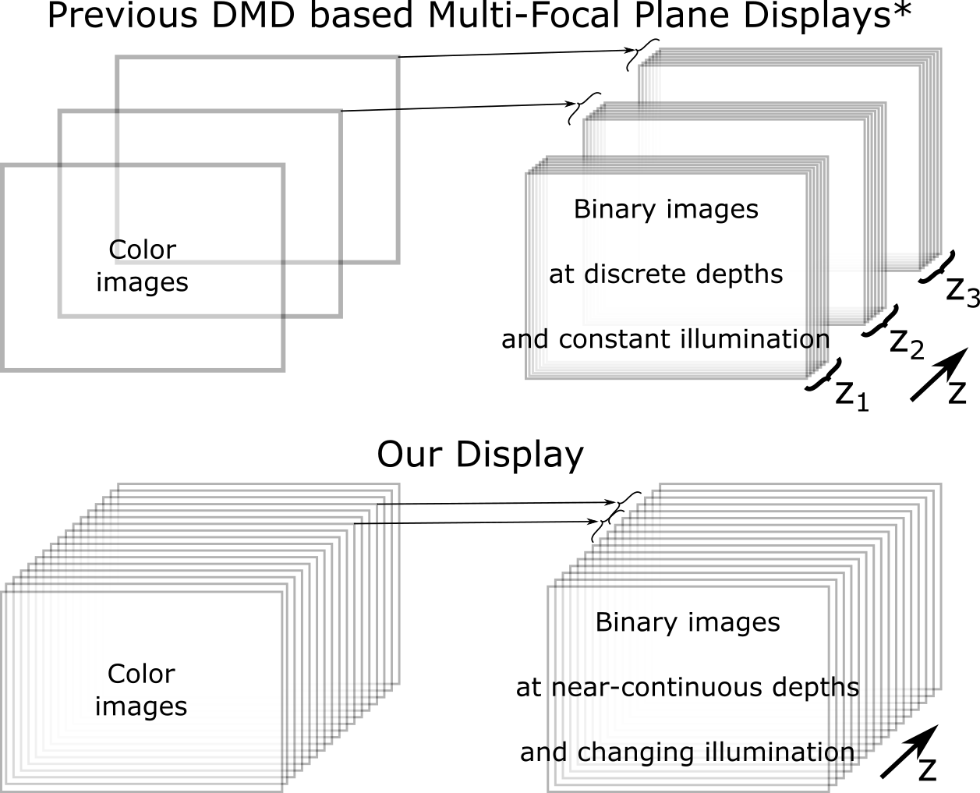
Comparison with Previous Time Multiplexed Binary Multi-Focal Plane Displays
Key differences:
Lens is driven in a continuous state
Illlumination is changed per-frame
Color to binary decomposition is per-voxel instead of per-image
* Hu et al., Applied Optics 2015, “Design and tolerance of a free-form optical system form an optical see-through multi-focal-plane display”
Notes:
In earlier approaches, the lens was stepped through certain focal states. Because these displays use a liquid lens, we would have to wait for the lens to settle down before presenting the image.
In our approach, we drive the lens in a continuous state, perform the decomposition on a per-voxel basis instead of per-image basis, and use an HDR illuminator.

Slide 22
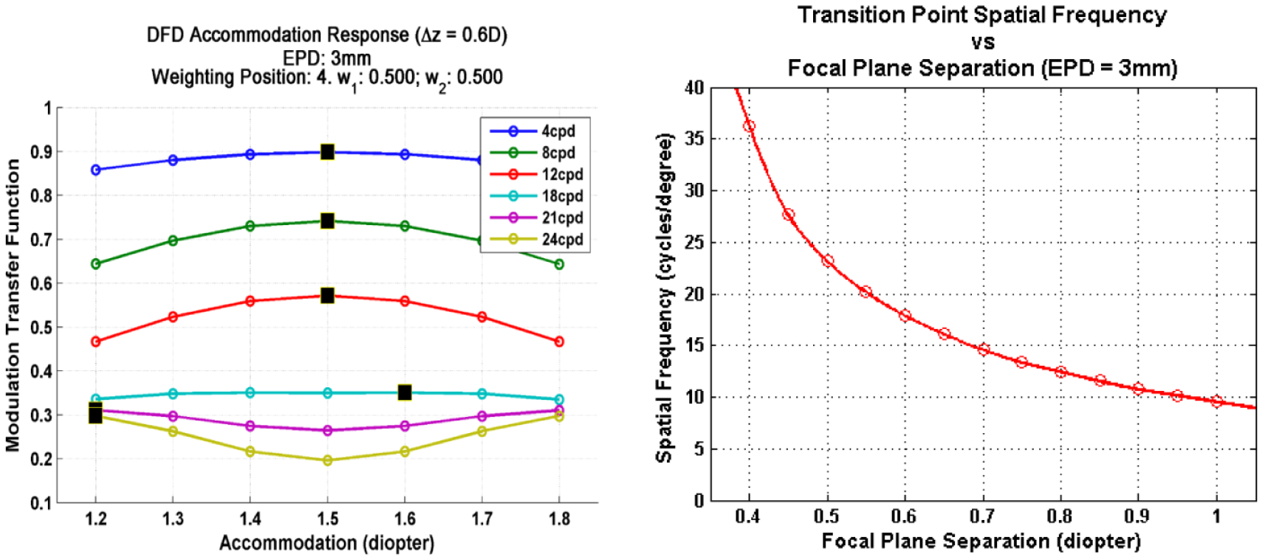
Comparison with Previous Time Multiplexed Binary Multi-Focal Plane Displays
Specs | Previous Approach | Our Approach
Number of depth planes | 6 | 280
Depth range | 0 – 3 D | 0.25 – 6.7 D
Depth blur | 0 D | 0.17 D
Bit-depth per color | 4 | 8
* Hu et al., Applied Optics 2015, “Design and tolerance of a free-form optical system form an optical see-through multi-focal-plane display”
Hua, IEEE 2017, Enabling Focus Cues in Head-Mounted Displays
Notes:
Here’s a comparison of key specs between our paper and the earlier papers. For a small penalty in depth blur, we are able to significantly increase the number of depth planes.
ADVANCE
This is very good for us because it has been shown that the spatial resolution in between the focal planes reduces a lot. So, by having more focal planes, we can maintain good spatial resolution across a larger volume.

Slide 23
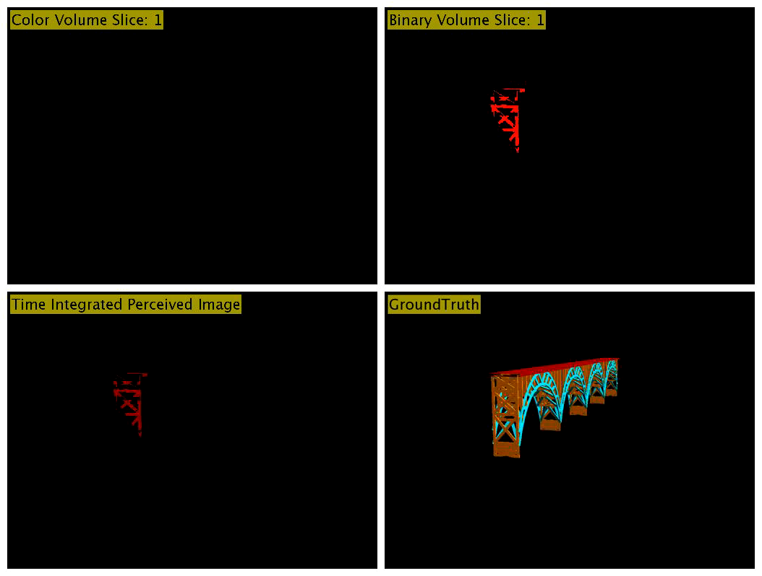
Rendering Pipeline Simulation
Notes:
Here's a simulation of our rendering pipeline. The top left shows the current color volume slice, the top right shows the current binary volume's slice, and the bottom left shows the time integrated view tha the user may perceive - but this doesn't show focus cues, we'll come to that later.

Slide 24
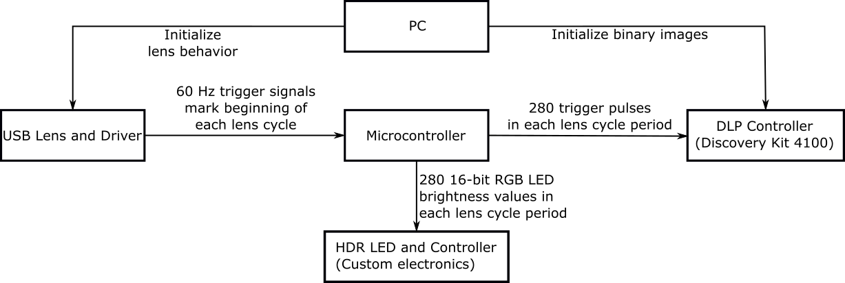
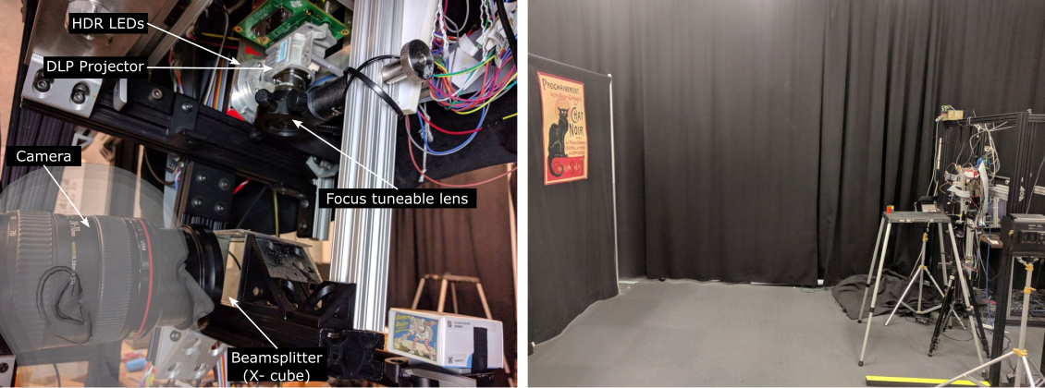
Implementation
Notes:
We tested our ideas with an off-line implementation for a static scene. To show a spatially registered demo, we placed several real world objects at difference distances from the display and placed virtual objects next to them.

Slide 25
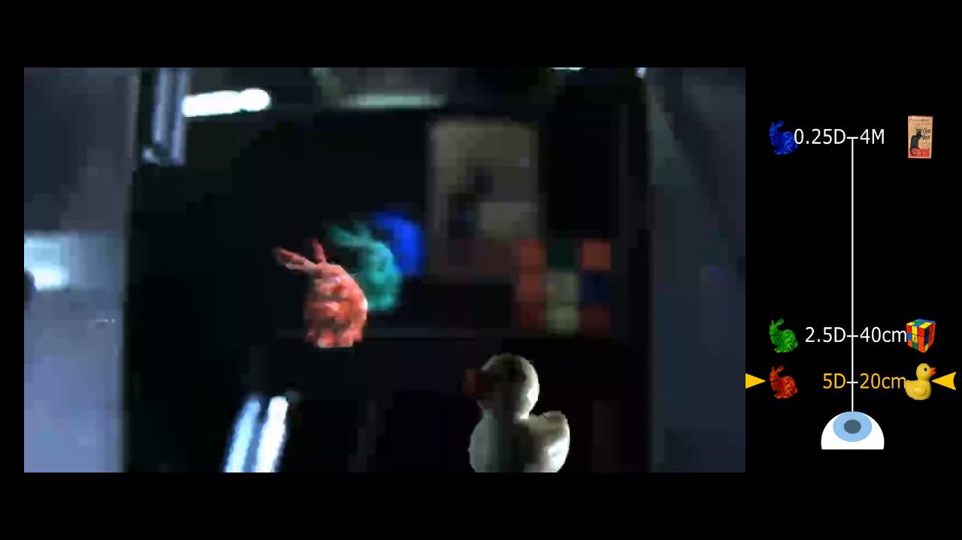
AR display in Operation
Only the recording camera focus is changed during the video
Flicker is not visible to humans
Notes:
The result of this algorithm can be seen in these videos. The legend on the right indicates the relative distances of the real and virtual objects. Objects to the left of the optical axis are virtual objects and the objects to the right are real objects. The camera's focus is changed manually by adjusting the focus lens of the camera. Changing the focus of the camera does not get communicated to the display - so the display is constantly showing the virtual objects at the various depths irrespective of the camera's focus setting.

Slide 26

AR display in Operation: showing continuous object
Only the recording camera focus is changed during the video
Flicker is not visible to humans

Slide 27
Limitations
Bulky Form-factor
Moderate form-factor may be possible (e.g. Avegant)
Non-zero pixel blur along depth
Without our simplifying assumptions, computation costs will increase

Slide 28
Future Work
Develop advanced color-to-binary decomposition algorithms
Content adaptive decomposition
Mixed primary color illumination
Depict transparency, reflection, participating media
Integrate real-time version with low-latency work
Develop more compact and wide field of view prototype

Slide 29
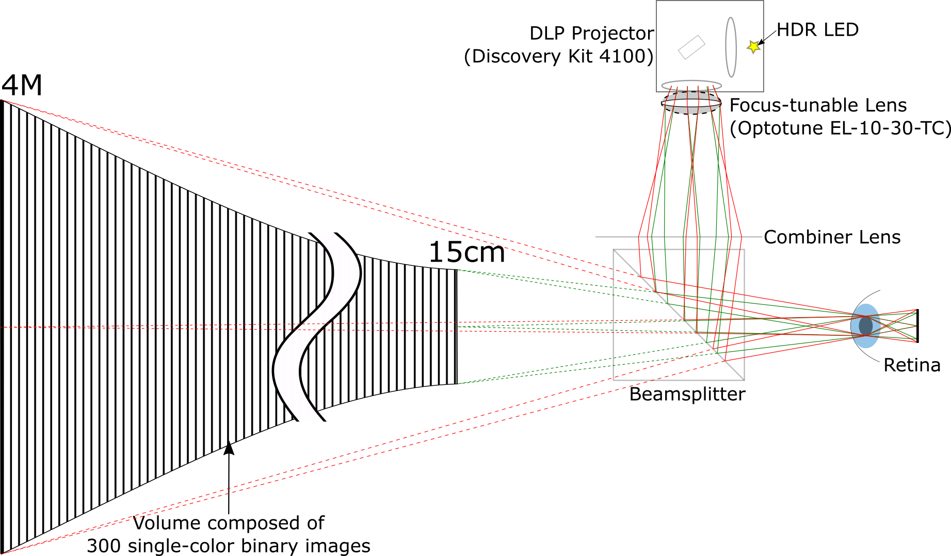
Thank you!

Slide 32
Extra slides

Slide 33
Related Work

Slide 34
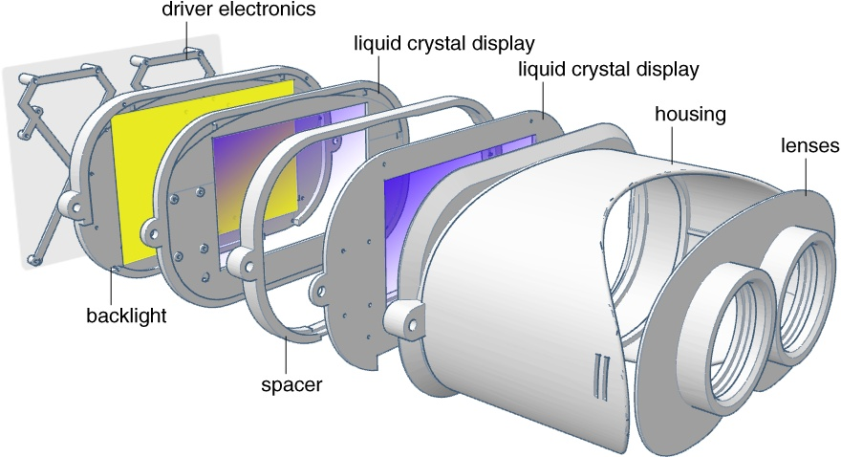
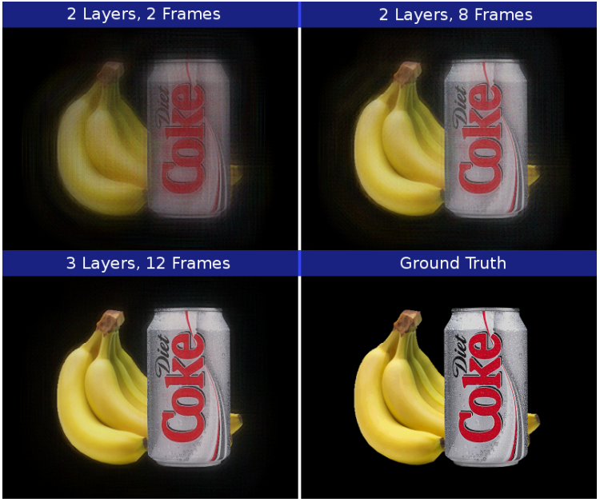
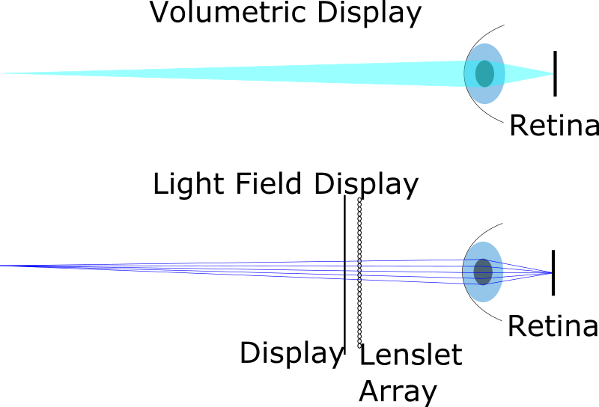
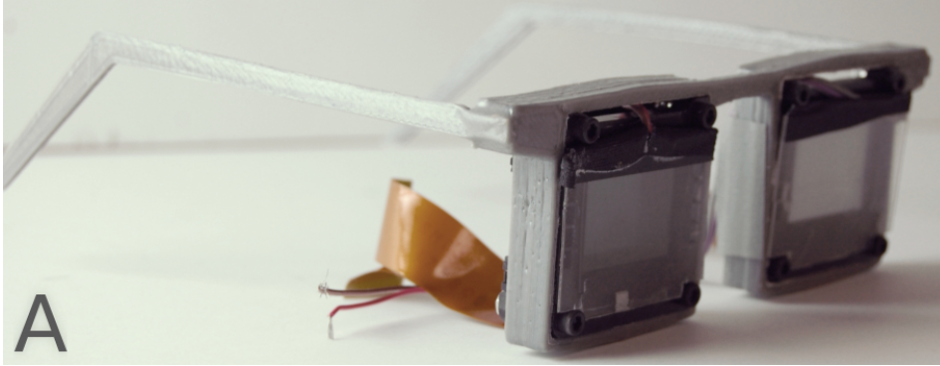
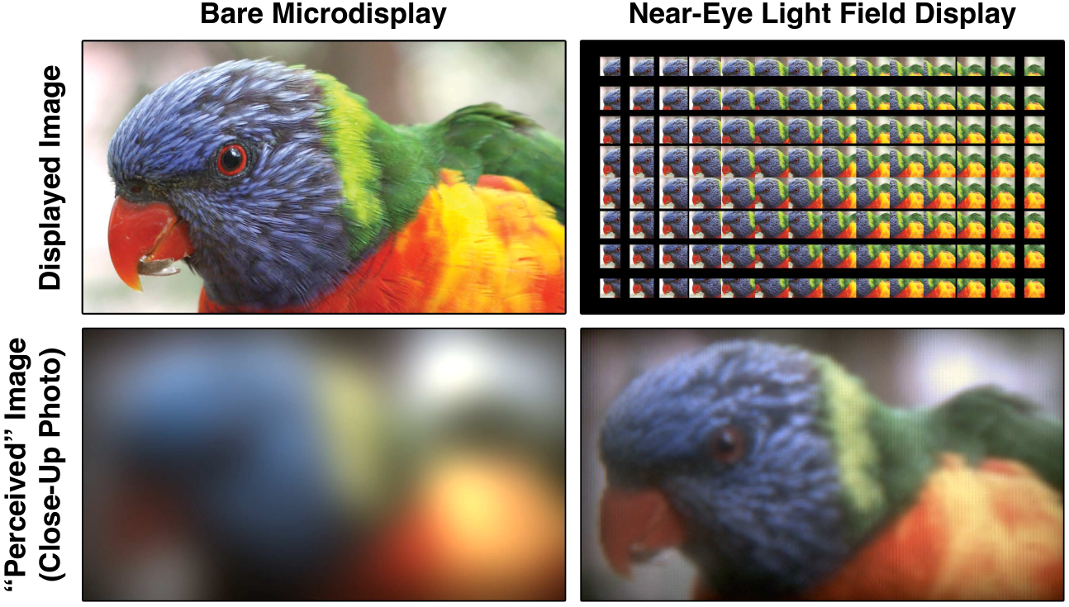
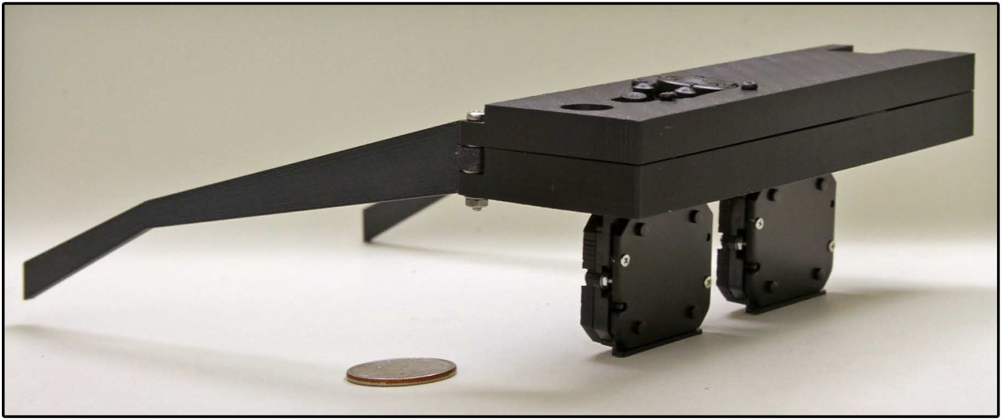
Limitations in previous Light Field Displays:
Low resolution due to spatial-multiplexing or diffraction
Diffraction limited
Spatial-angular trade-off
Lanman and Luebke, Siggraph 2013, “Near-eye Light Field Displays”
Maimone and Fuchs, ISMAR 2013, “Computational Augmented Reality Eyeglasses”
Huang et al., Siggraph 2015, “The light field stereoscope Immersive computer graphics via factored near-eye light field displays with focus cues”

Slide 35
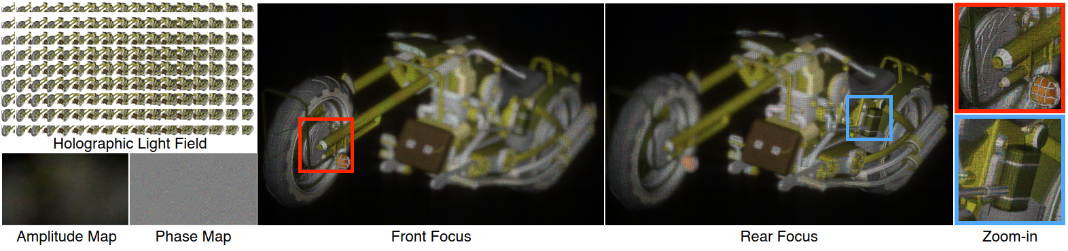
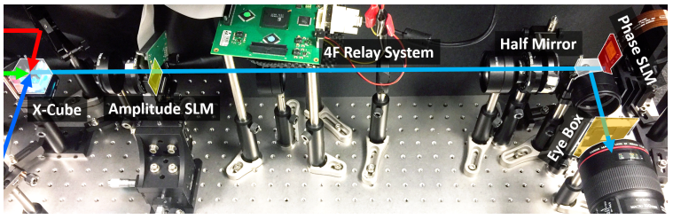
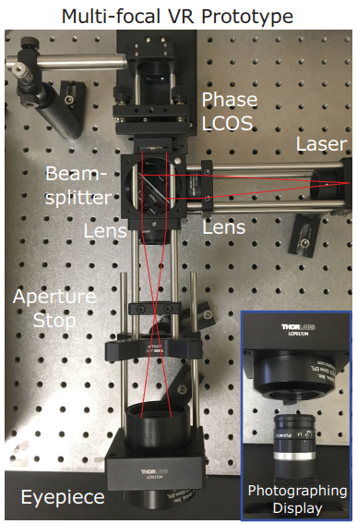
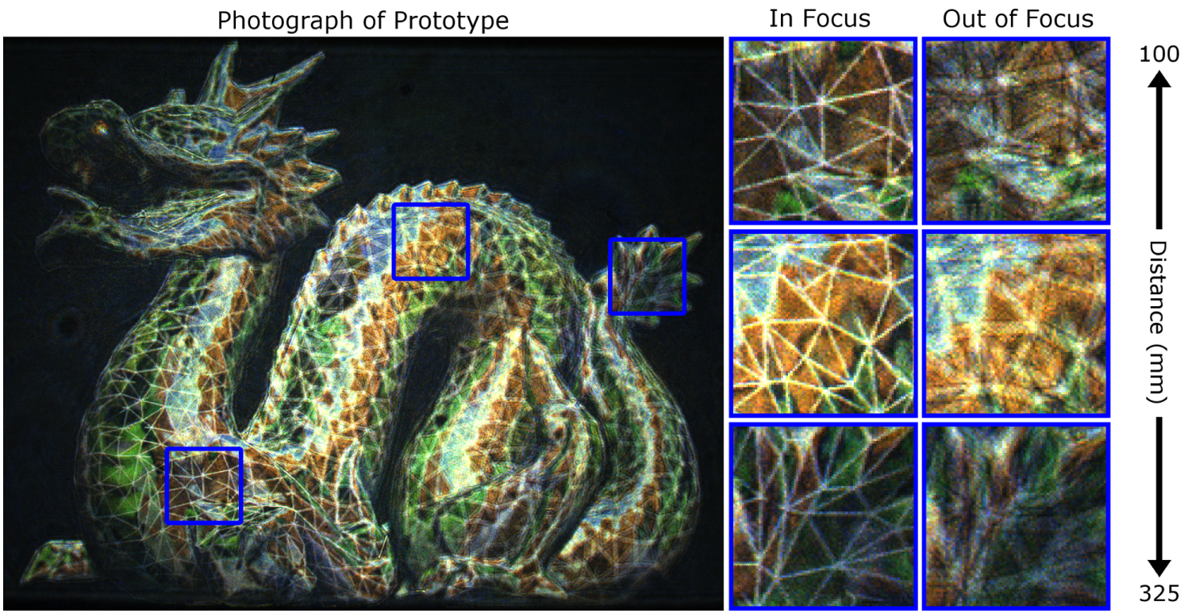
Limitations in previous Holographic Displays:
Small eyebox, field-of-view, depth of field. Large form-factor.
Shi et al., SIGGRAPH ASIA 2017, Near Eye Light Field Holographic Rendering with Spherical Waves for Wide Field of View Interactive 3D Computer Graphics
Maimone et al., SIGGRAPH 2017, Holographic Near-Eye Displays for Virtual and Augmented Reality

Slide 36
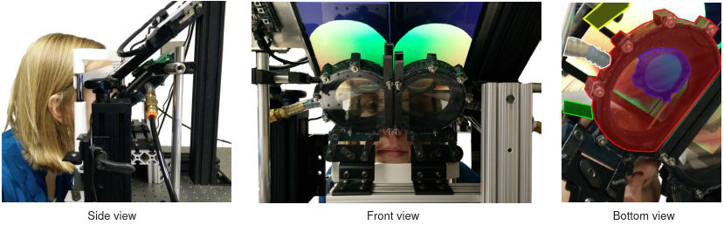
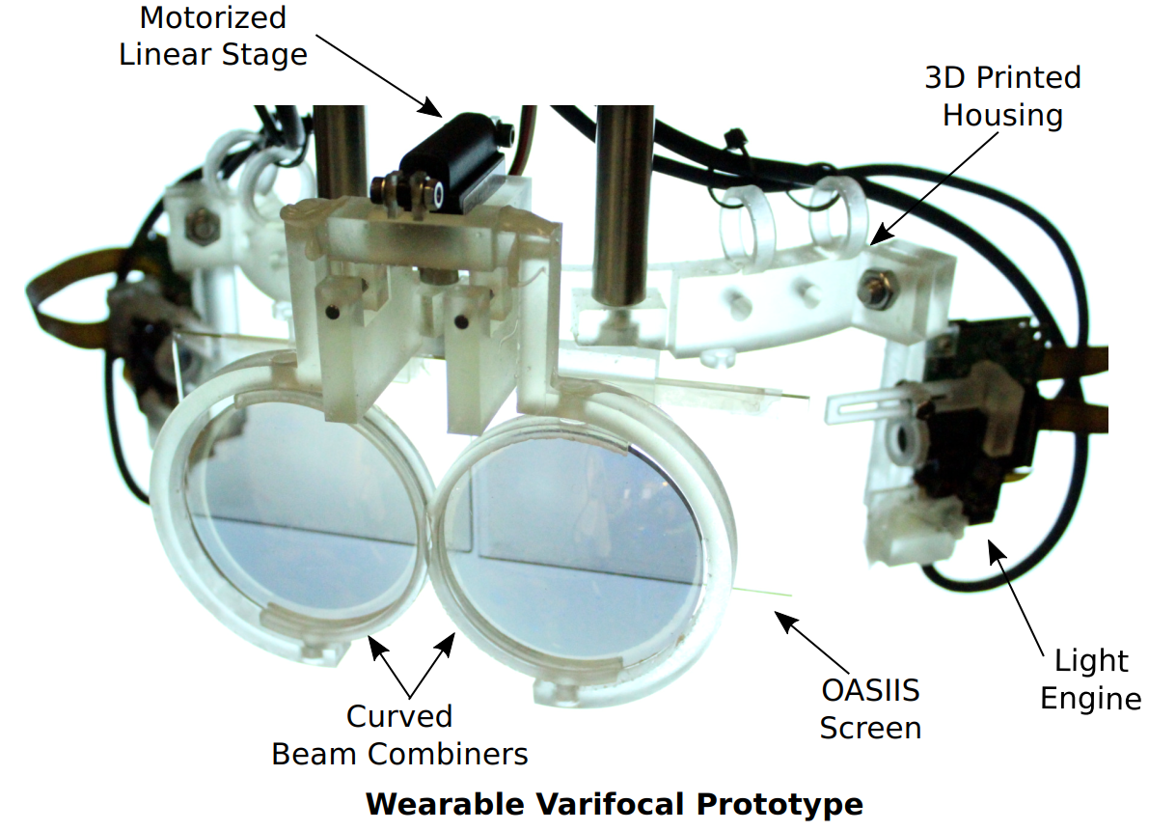
Limitations in previous Varifocal Displays: Latency
Latency, degradation of deformable membrane over time
Latency
Dunn et al., TVCG 2017, Wide Field Of View Varifocal Near-Eye Display Using See-Through Deformable Membrane Mirrors
Aksit et al., SIGGRAPH ASIA 2017, Near eye varifocal augmented reality display using see-through screens

Slide 37
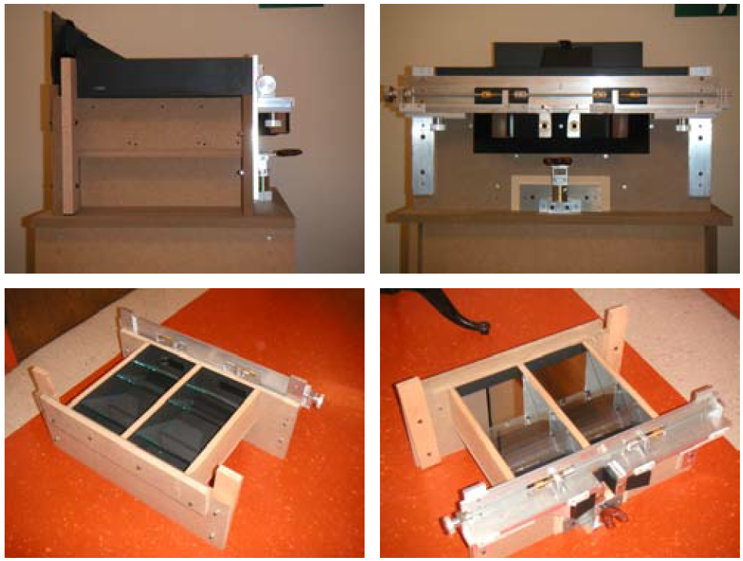
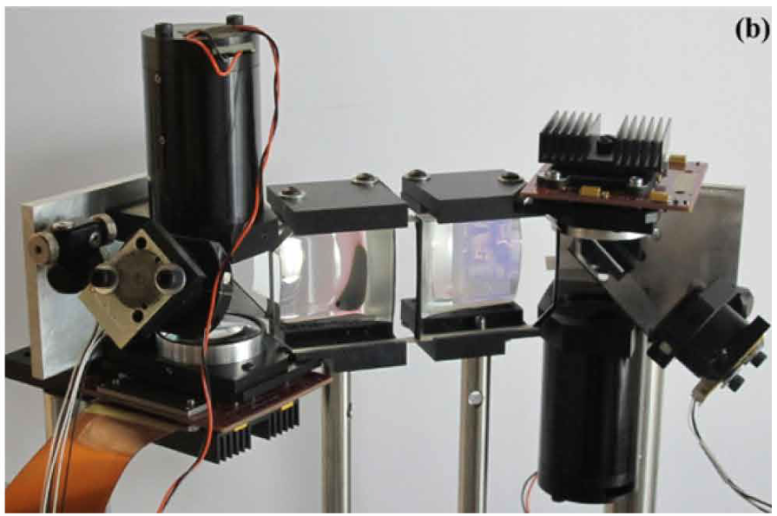
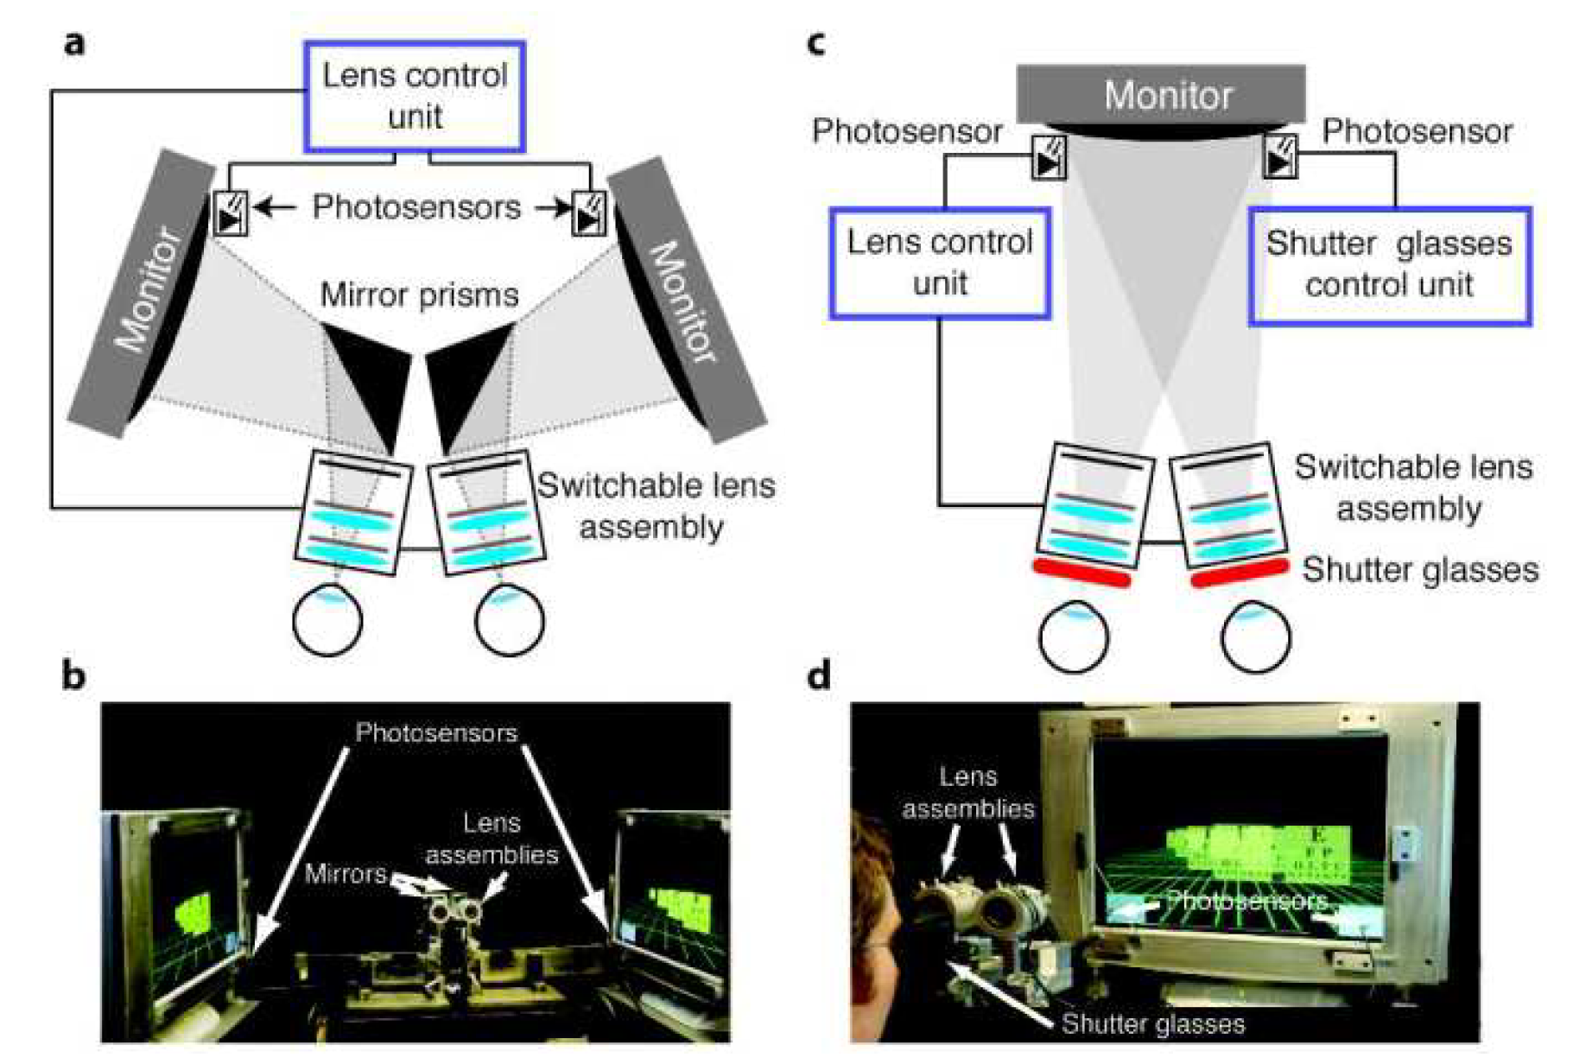
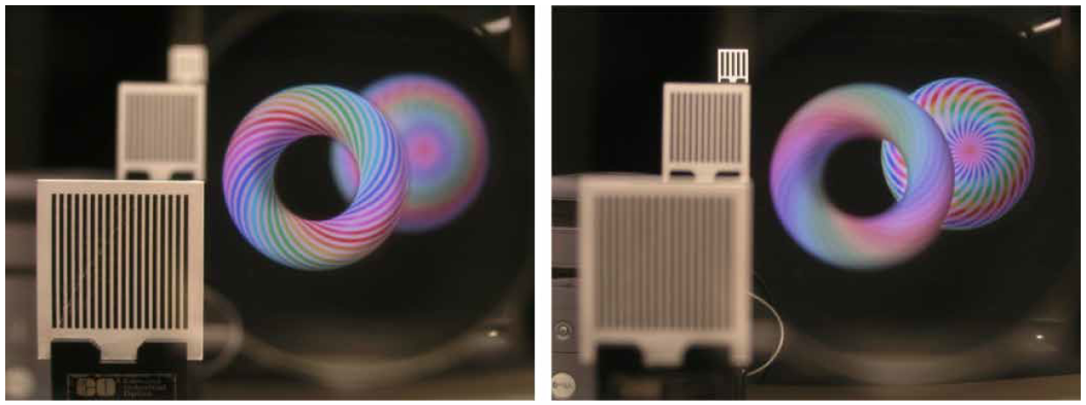
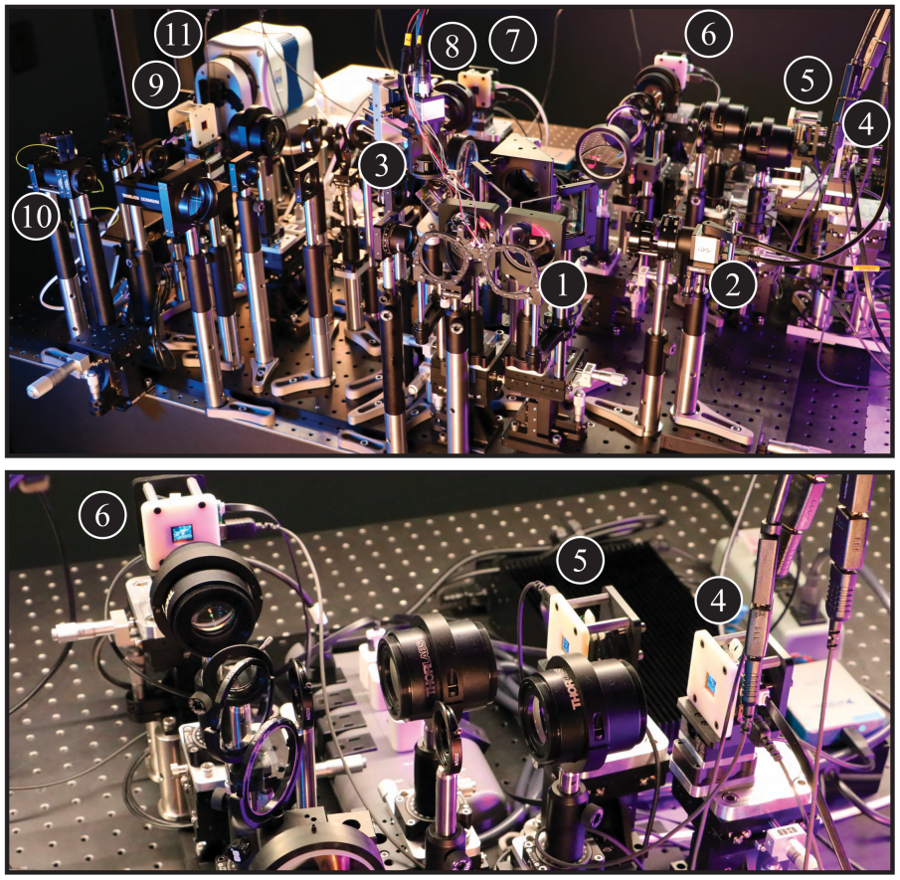
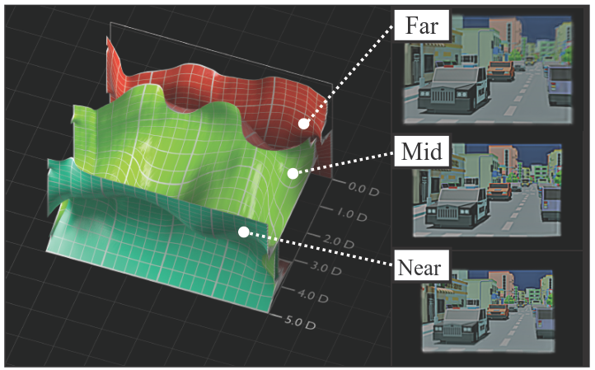
Limitations in previous Multifocal Displays: Few focal planes
Multi-Focal Plane Displays
Spatially Multiplexed Displays
and
Multiple Displays
Time Multiplexed Displays
Using Binary Display
Using Color Display
Our Work
Akeley et al., Siggraph 2004, “A Stereo Display Prototype with Multiple Focal Distances”
Liu and Hua, Opt. Letters 2009, “Time-multiplexed dual-focal plane head-mounted display with a fast liquid lens”
Love et al., Optics Express 2009, “High-speed switchable lens enables the development of a volumetric stereoscopic display”
Hu et al., Applied Optics 2015, “Design and tolerance of a free-form optical system form an optical see-through multi-focal-plane display”
Matsuda et al., Siggraph 2017, “Focal Surface Displays”
Mercier et al., Siggraph Asia 2017, “Fast gaze-contingent optimal decompositions for multifocal displays”

Slide 38

Previous Multi-Focal Plane Displays
Few focal planes
Need blending algorithm to represent in-between objects
Loss of resolution for in-between objects
Akeley et al., Siggraph 2004, “A Stereo Display Prototype with Multiple Focal Distances”
Hua, IEEE 2017, “Enabling Focus Cues in Head-Mounted Displays”
Notes:
Because of the few focal planes in MFP displays, objects in between the focal planes need to depicted by some scene decomposition algorithm that simulates the correct retinal defocus blur.
However, this comes at a cost of reduced resolution and contrast to show the in-between objects.
The basic take-away from this slide is that the higher the number of focal planes, the better the MFP display’s performance.

Slide 39


Rendering Pipeline
Color to Binary + Illumination
High-Speed High Dynamic Range LEDs
3 parallel 16-bit DACs control RGB LED
Pulse Modulation Scheme: Direct Digital Synthesis (DDS)
Lincoln et al., i3D 2017, Scene-adaptive high dynamic range display for low latency augmented reality
Notes:
HF: consider cutting this slide; not important

Slide 40
Previous Light Field Displays
Previous LF Displays
Lower resolution or lower frame-rate
Small eyebox
Lanman and Luebke, Siggraph 2013, “Near-eye Light Field Displays”
Maimone and Fuchs, ISMAR 2013, “Computational Augmented Reality Eyeglasses”
Huang et al., Siggraph 2015, “The light field stereoscope Immersive computer graphics via factored near-eye light field displays with focus cues”

Slide 41




Unfolded Optical Layout

Slide 42

Unfolded Optical Layout

Slide 43

Distribution of Binary Focal Planes
Specs:
Lens - 60 Hz
DMD - 16,800 Hz
Overall display frame-rate: 60 Hz
In each lens cycle:
280 binary focal planes, each at different depth
20 cm to 4 M
(5 diopters to 0.25 diopters)
Notes:
Point out the range of depth.
Point out that within the cycle, the image goes back and forth - two opportunities to display imagery. Alternatively, we could display a new frame for every half the cycle of lens - the display frame rate would be twice the lens frame rate.
Point out changing FoV which is ignored for now.

